Slide 1
PERIOPERATIVE MANAGEMENT OF HYPERTENSIVE PATIENTS

Slide 2
Case 1
A 45 YEARS Old married female with NKCM admitted via opd with c/o;
Right upper quadrant pain----5 days
Nausea and vomitings ---3days
Daignosis of acute cholecystitis is made and patient is kept on list for cholecystectomy.
During pre op workup she has
Baselines normal

Slide 3
Vitals;
BP 140/90
PULSE 80Bpm
Temp AF
Your House Surgeon Informs you that she has blood pressures on higher side since admission
Bp checked on 2 separate occasions from both arms
Right :140/90 Left 130/90

Slide 4
DEFINITION
The new Hypertension Guideline changes the definition of hypertension, which is now considered to be any systolic BP measurement of 130 mm Hg or higher—or any diastolic BP measurement of 80 mm Hg or higher.

Slide 5

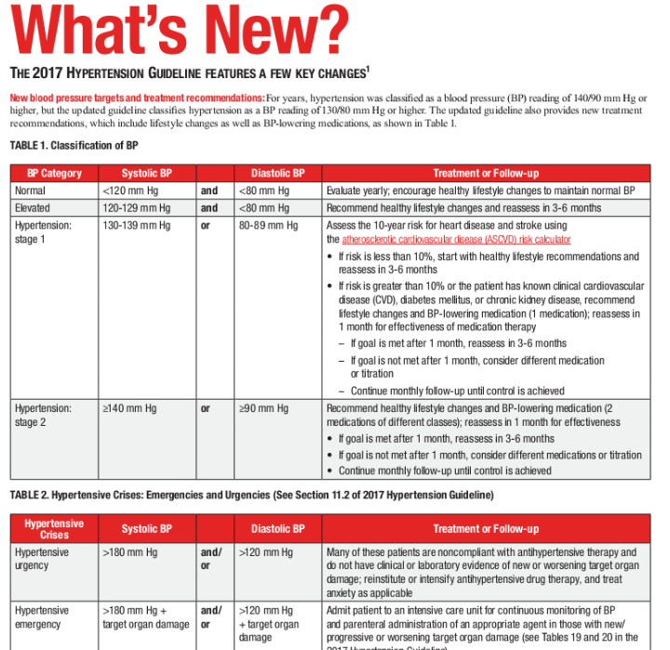

Slide 6

Choice of antihypertensive IN CASE 1
Adult with HTN Without DM (Under55years)
STEP 1:ACE INHIBITOR OR ARB
STEP 2:Add CCB or thiazide Diuretic

Slide 7
CASE 2
50YEARS Old male known diabetic(since last 3years) and hypertensive(for last 1 year, Not taking any Rx)admitted via opd with c/o:
Large swelling in front of neck _________since 2 years
Daignosis ; multinodular goiter
He has been kept on list for thyroidectomy.
Surgeon advised pre op workup.

Slide 8
Family histry positive for ischemic heart disease
O/E:
VITALS:BP 150/100
PULSE 88Bpm
Temp AF
Bp readings consistently higher
LABS :normal except thyroid profile

Slide 9
Choice of antihypertensive in case 2
Pt is diabetic and hypertensive
Step 1
ACE I OR ARB
If Rx is not responding OR pt is not tolerating well because of cough
Step 2
Add CCB or Thaizide diuretic
No response
Step 3
3 drug regime:ace i+ccb+thaizide

Slide 10
Case 3
70 years old male kc asthma and HTN admitted in surgical ward for ileostomy reversal.
On inquiring pt tells he has been diagnosed HYPERTENSION few months back during his pre op workup and he was started on tab AMLODIPINE OD.

Slide 11
Vitals on admission
Bp 150/95 ( same on 4 occasions)
Pulse 70 Bpm
Temp AF
Attendant says pt is well compliant to medicines.

Slide 12
Choice of antihypertensive in case 3

Slide 13
INTRODUCTION
One of the most common worldwide disease
Worldwide, hypertension may affect as many as 1 billion people and be responsible for ~7.1 million deaths per year (WHO 2002)
Perioperative hypertension is commonly encountered in patients posted for surgery
Many of these patients come to know of their hypertension for the first time when they come for checkup for some other reason

Slide 14
PRE OPERATIVE HYPERTENSION
Preexisting hypertension is the most common medical reason for postponing surgery .
Hypertension is well known to be a risk factor for cardiovascular catastrophe, a risk that logically extends into the perioperative period .
In a case-control study of 76 patients who died of a cardiovascular cause within 30 days of elective surgery, a preoperative history of hypertension was four times more likely than among 76 matched controls

Slide 15
Perioperative hypertension occurs in 25% of hypertensive patients that undergo surgery
During surgery, patients with and without preexisting hypertension are likely to develop blood pressure elevations and tachycardia during the induction of anesthesia.
Common predictors of perioperative hypertension are previous history of hypertension, especially a diastolic blood pressure greater than 110 mm Hg, and the type of surgery.

Slide 16
Considering the prevalence of chronic hypertension, the management of patients with chronic hypertension undergoing surgery is of major clinical importance as these patients are at an increased risk of morbidity and mortality after surgery
Patients with preexisting hypertension are more likely to experience intraoperative blood pressure lability (either hypotension or hypertension) , which may lead to myocardial ischemia

Slide 17
ACC/AHA Perioperative Guideline
Stage 1 hypertension
no need to delay surgery or escalation in
medical therapy
In stage 2 hypertension
antihypertensive therapy should be weighed
against the risk of delaying surgery

Slide 18
PRE OPERATIVE MEASURES
All elective surgery patients with cardio vascular risk factors should undergo pre operative optimization
control of BP,
correction of electrolytes,
cessation of smoking,
glucose control etc.

Slide 19
Prior to elective surgery blood pressure should be controlled to near 160/100mmHg.
Ref baily &love 27th edition

Slide 20
TREATMENT OF PRE OP HTN
The choice of agent in specific cases should be determined by the clinical situation, the patient’s characteristics, the setting of care, and the experience of the clinicians.

Slide 21
Treatment of perioperative hypertension is
considerably different than that of chronic
hypertension
prevention
antihypertensive medication starting several
days before surgery
should be continued during the perioperative

Slide 22
Diuretics
Both loop and thiazide-type diuretics:
Hypokalemia
arrhythmia, paralytic ileus
potentiated the effects of muscle
relaxants used during anesthesia
Hypovolemia
Hypotension due to systemic vasodilation
Continue up to day of surgery,
but discontinue morning dose

Slide 23
ACEi or ARB
Blunt the compensatory activation of the reninangiotensin system during surgery prolonged hypotension
continue to the day of surgery
HF or low BP: discontinue morning dose

Slide 24
Calcium channel blockers
• Associated with trends toward reduced MI/death
(diltiazem), atrial arrhythmia (verapamil)
• No serious interaction with anesthetic agent
• Withdrawal syndrome is not typical
• Conflicting evidence on increasing risk of bleeding
Continue up to and including
day of surgery

Slide 25
Perioperative Hypertension occurs during
a) Induction of anaesthesia
b) Intraoperative due to pain induced sympathetic stimulation
c) Hypothermia
d) Hypoxia
e) Intravascular volume overload
f) 24 to 48 hours post op as fluid is mobilized from extravascular space

Slide 26
Preoperative hypertension is frequently a hypertensive urgency, not an emergency, as it typically does not involve end organ damage and there usually adequate time to reduce the BP
Data suggest that diastolic blood pressure of ≥110 mm Hg is a preoperative marker of perioperative cardiac complications in patients with chronic hypertension

Slide 28
IN A NUT SHELL
At least 25% of patients undergoing noncardiac surgery have hypertension prior to their surgical procedure; elevated blood pressures (eg, systolic ≥170 mm Hg, diastolic ≥110 mm Hg) have been associated with complications such as myocardial ischemia
REF(Goldman et al 1977, 1997).

Slide 29
In a multivariate analysis of risk factors for perioperative complications in men who underwent noncardiac surgery, the presence of preoperative hypertension increased the odds ratio for postoperative death to 3.8 times that of normotensives
(Browner et al 1992).
In a case-controlled study of patients who died of a cardiac cause within 30 days of elective surgery, a preoperative history of hypertension was 4 times more likely than in an equal number of age-matched controls
(Howell et al 1996).

Slide 30
Slide Title
Product A
Product B
Feature 1
Feature 2
Feature 3
Feature 1
Feature 2
Feature 3

Slide 31
Case Discussion #1
• #1) M/45 BP 180/115 mmHg, HR 98 bpm
→ Adm. for femur shaft open fracture op. d/t TA
→ HTN(+) – 6 yrs, no medication
→ No other medical history
Hypertensive urgency
No cardiac risk
Emergency op Ix.
➔ Parenteral Agents

Slide 32


